Slide 1

AUTOMATED PET FEEDER

Slide 2

PROBLEM STATEMENT
Pet owners often struggle with feeding schedules, especially when they are busy or away from home. Manual feeding may lead to irregular meal times, overfeeding, or underfeeding.

Slide 3
ABSTRACT
This project develops an automated pet feeder that dispenses food at scheduled times and controlled portions. The system integrates IoT technology, sensors, and a mobile application for remote control and monitoring.

Slide 4
INTRODUCTION
The automated pet feeder ensures pets receive timely and appropriate meals without owner intervention. It enhances convenience and ensures pets maintain a healthy diet.

Slide 5
KEY FEATURE
Scheduled and portion-controlled feeding
IoT-enabled remote monitoring and control
Voice command support for hands-free operation
Food level and pet consumption tracking
Battery backup for uninterrupted functionality

Slide 6
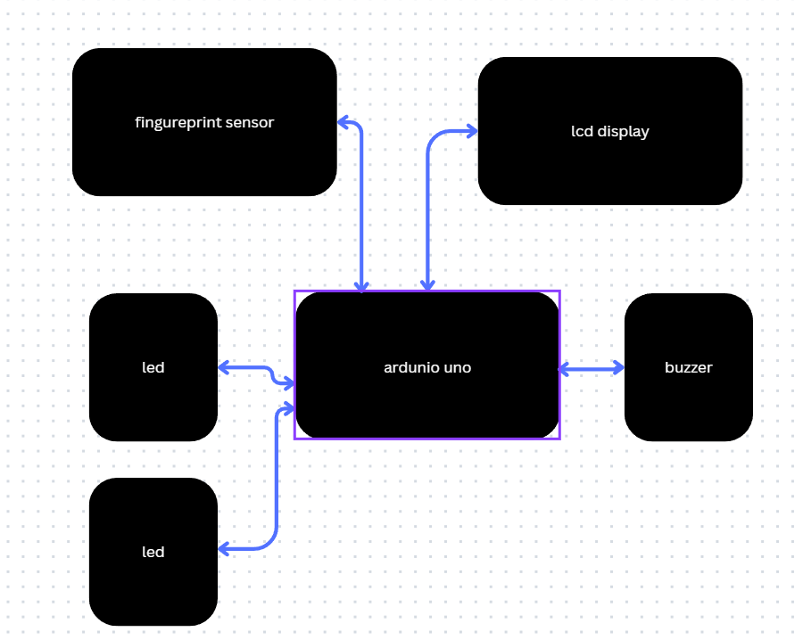
BLOCK DIAGRAM

Slide 7
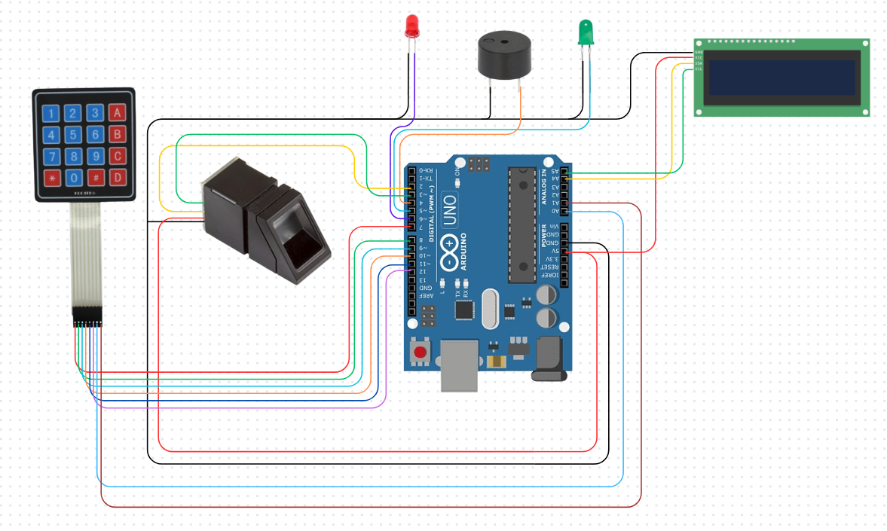
CIRCUIT DIAGRAM

Slide 8
USE CASE
Ideal for pet owners with busy schedules
Ensures dietary consistency for pets with special needs
Helps manage pet weight and portion control
Provides feeding automation for multi-pet households

Slide 9
OUTCOME
Ensures pets receive food on time, reducing health risks
Enhances pet owner convenience with automated control
Provides real-time monitoring for better pet care

Slide 10
CONCLUSION
The automated pet feeder offers a smart, reliable solution for pet owners. Future enhancements may include AI-based portion recommendations, integration with pet health monitoring apps, and real-time video monitoring.

